Slide 1
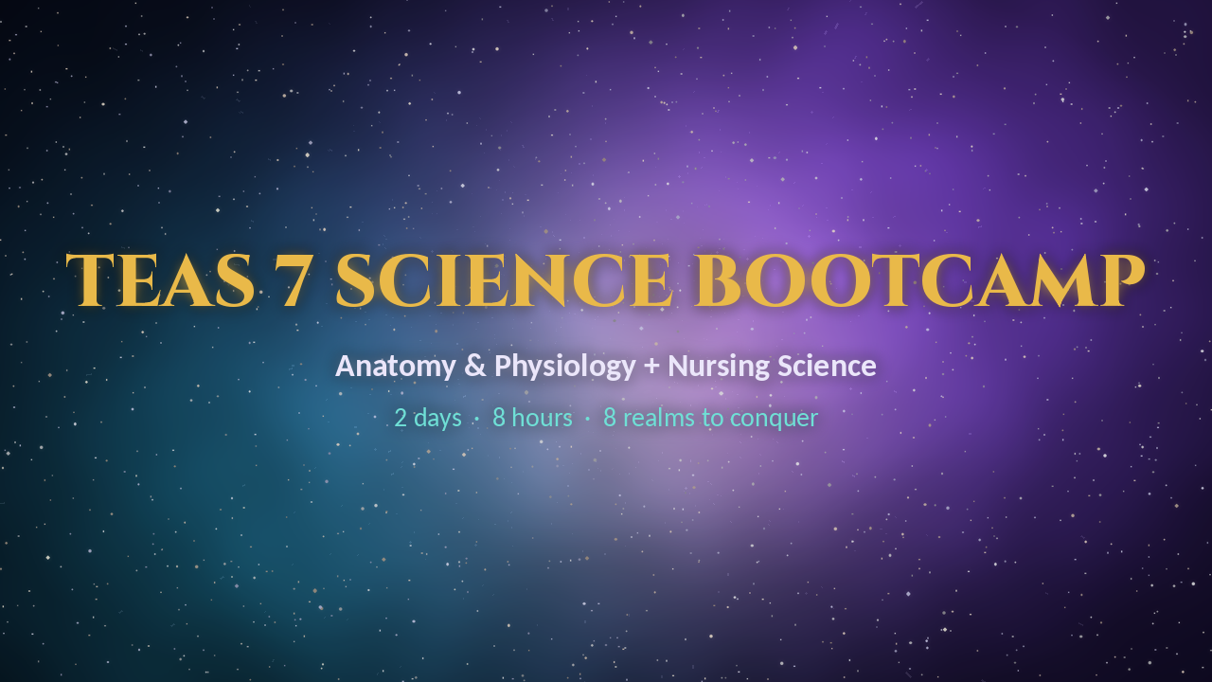

TEAS 7 Science Bootcamp
♪ Music on / off
Notes:
Cold open: the intro video and the background soundtrack start automatically. The music loops quietly until the next realm divider, where it starts again. Click the gold "Music on / off" button (here and on every realm divider) to pause or resume it.

Slide 2


TEAS 7 Science Bootcamp
Anatomy & Physiology + Nursing Science Review
By Dr. Joannes Paulus Tolentino Hernandez
2 Days × 4 Hours · Fall 2026 · j.hernandez@amg.edu
Notes:
Welcome everyone. Two days, eight one-hour realms. Every hour: teach, play, rest. The profile video plays automatically when this slide opens (click it to pause or replay).

Slide 3
Your mission: the TEAS science section
50
questions
60
minutes
~1
minute each
A&P first!
Anatomy & Physiology is 18 of the 44 scored questions: the biggest piece of the science score.
Target: 75%+ in science
No partial credit on "select all" items.
Notes:
Science = 50 questions in 60 minutes, about 1 minute each. A&P is 18 of the 44 scored questions, so we start with A&P. Priority stars come from the guide.

Slide 4



How to win: question types and the study loop
Hot spot
Click the organ or region on a picture
The study loop
1 Read
2 Cover
Ordered response
Drag steps into order (like blood flow)
3 Recall
4 Practice questions
Fill in the blank
Type the term from memory
5 Revisit in 2 days
Repeat the loop: spaced recall beats rereading.
Notes:
Expect hot-spot, ordered-response and fill-in items. Study loop from the guide: read, cover, recall, practice questions, revisit in 2 days.

Slide 5
Bootcamp map: 2 days × 8 realms
Click a realm to jump to its hour
DAY 1
Hour 1
Gloomhallow Manor
Exam basics + A&P foundations
Name planes, directions, tissues and feedback types
Hour 2
Emberheart Caldera
Heart & blood + lungs
Recite blood flow through the heart; explain acidosis vs alkalosis
Hour 3
Stormspire Nexus
Nervous + endocrine
Compare sympathetic vs parasympathetic; match glands to hormones
Hour 4
The Gumdrop Gut Works
Digestive + urinary
Trace food and urine; explain ADH and aldosterone
DAY 2
Hour 5
The Rattling Gymnasium
Bones, muscles, skin
Explain blast vs clast, muscle types, skin layers and glands
Hour 6
Bastion of Wards
Immune/lymphatic + reproductive
Fill in the active/passive immunity grid; name antibody types
Hour 7
The Mad Alchemist's Lab
Biology + chemistry
Match organelles; do a Punnett square; read pH; name reaction types
Hour 8
The Sandglass Archive
Scientific reasoning + timed quiz + cram sheet
Identify variables; score 75%+ on the timed quiz
Notes:
Each hour has a matching game realm. Click any realm tile in Slide Show to jump to that hour; each realm title slide has a "Realm map" link to come back here.

Slide 6
Every hour has the same rhythm
45 min · Teach
Short bursts, one system at a time, with a memory hook and a nursing link.
10 min · Quiz or game realm
Play that hour's realm in Realms of Anatomica (or 3 quick questions).
5 min · Break
Stand up, stretch, hydrate.
Start of Day 2: the first 5 minutes of Hour 5 are a rapid recall of Day 1.
Notes:
Each hour = 45 minutes teaching + 10 minutes quiz or game realm + 5 minutes break. Lunch and breaks between days are outside the 8 hours.

Slide 7





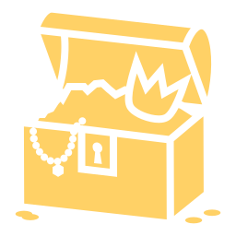

Play the game: Realms of Anatomica
Boss battle
6 correct answers defeat the boss; 3 wrong (or timeouts) end the attempt.
Scoring
Each attempt = % correct. Attempts are averaged; you choose your final.
3 attempts per realm
The next realm opens after a final is locked. Day 2 opens after Hour 4.
Save & continue
Pause any battle; resume within 24 hours with points kept.
▶ Open the game
Mystery chests
Extra heart, extra time, points, or two wrong answers removed.
PDF report
After all 8 realms, download your report and submit it.
stellarlifetech.github.io/ANATOMICA
Scan the code or click. 50 questions per realm, 400 in all.
Notes:
Realms of Anatomica: one realm per bootcamp hour, 50 questions each. No student sign-in; play both days on the same device and browser because progress is saved there.

Slide 8
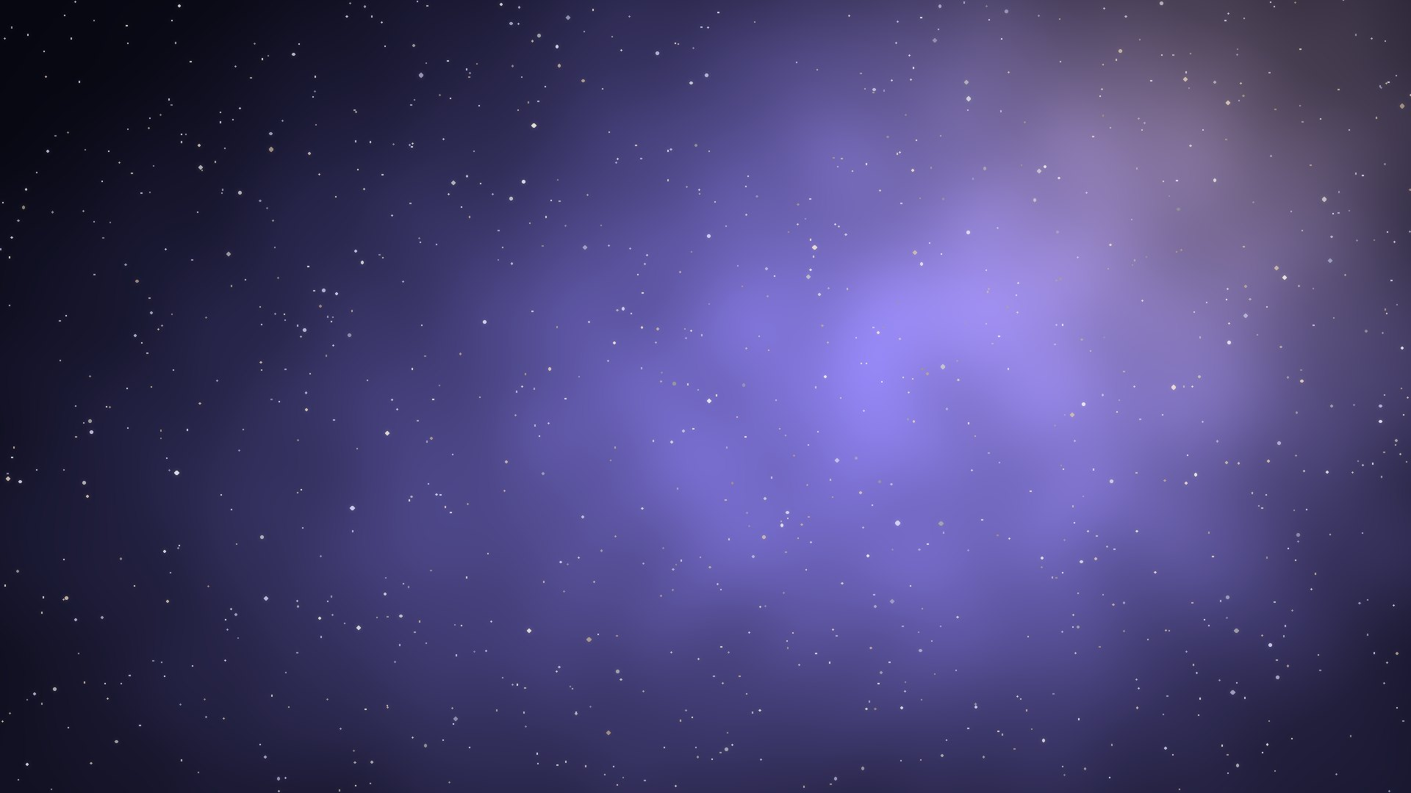

Gloomhallow Manor
DAY 1 · HOUR 1
Exam basics + A&P foundations
Boss: The Levitating Butler
You leave able to…
Name planes, directions, tissues and feedback types
♪ Music on / off
⌂ Realm map
Notes:
Hour 1 (Day 1): Exam basics + A&P foundations. Plan: 45 minutes teaching, 10 minutes quiz or game realm (Gloomhallow Manor), 5 minutes break. Goal: Name planes, directions, tissues and feedback types.

Slide 9

Anatomical position & direction pairs
Always picture anatomical position
Standing, facing you, palms forward. Left and right = the PATIENT'S left and right.
Superior / inferior = head / feet
Anterior / posterior = front / back
Medial / lateral = toward / away from the midline
Proximal / distal = near / far from where a limb attaches (limbs only)
Superficial / deep = surface / inside
Face the class like the patient: palms forward.
Notes:
Have students stand in anatomical position. Point superior/inferior, anterior/posterior, medial/lateral. Proximal/distal is for limbs only.

Slide 10
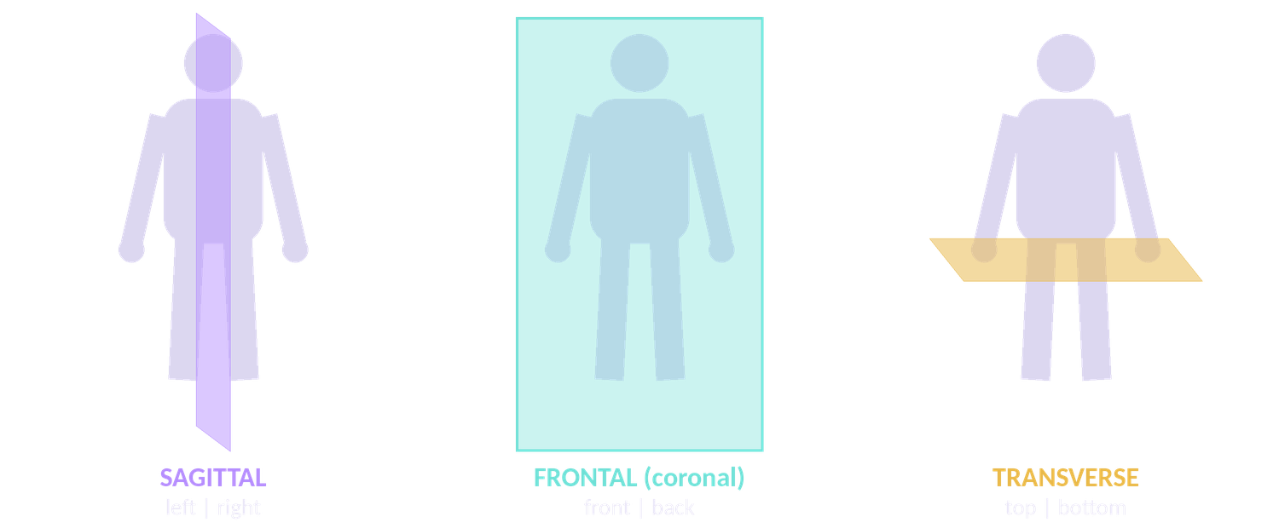
Planes: "Split Front Top"
Split
Front
Top
Notes:
Sagittal splits left | right, Frontal (coronal) splits front | back, Transverse splits top | bottom: "Split Front Top".

Slide 11
Cavities & the four quadrants
Body cavities
Dorsal = brain + spinal cord.
Ventral = thoracic (heart, lungs) + abdominopelvic, split by the diaphragm.
Kidneys sit BEHIND the peritoneum (retroperitoneal).
Patient's RIGHT
Patient's LEFT
RUQ
LUQ
Liver + gallbladder
Stomach + spleen
RLQ
LLQ
Try it: click a quadrant
The patient faces you, so the patient's RIGHT is on YOUR left. Click each quadrant to reveal its organs.
Appendix
Sigmoid colon
Notes:
Interactive: in Slide Show, click each quadrant to reveal its organs (RUQ liver/gallbladder, LUQ stomach/spleen, RLQ appendix, LLQ sigmoid colon). Remind students: the patient's right is on your left.

Slide 12
Levels of organization & the 4 tissues
"Cats Can Take Over Our Office"
4 tissues: "ECMN" = Every Cell Must Network
E Epithelial
Covers and lines (skin, gut lining). No blood vessels.
C Connective
Supports: bone, blood, fat, tendons.
O · Organism
O · Organ system
O · Organ
T · Tissue
M Muscle
Moves.
N Nervous
Signals.
C · Cell
C · Chemical
Notes:
Levels: Chemical → Cell → Tissue → Organ → Organ system → Organism ("Cats Can Take Over Our Office"). Tissues: ECMN, "Every Cell Must Network". Epithelium has no blood vessels.

Slide 13

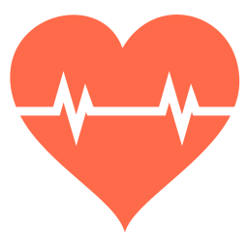
Feedback loops
Negative feedback = REVERSES the change
The most common type.
Too hot → sweat → cooler.
High blood sugar → insulin → sugar falls.
Positive feedback = AMPLIFIES until done
Labor contractions (oxytocin).
Blood clotting.
Breastfeeding.
Positive = Babies and Blood
Notes:
Negative feedback reverses the change (most hormones and body temperature). Positive feedback amplifies until an event ends: labor, clotting, breastfeeding. Hook: Positive = Babies and Blood.

Slide 14
Boss battle · Hour 1 · Question 1 of 3
Gloomhallow Manor vs The Levitating Butler
Q1. Which plane divides the body into left and right?
A Frontal
B Transverse
✗ Try again
✗ Try again
C Sagittal
D Coronal
✓ Correct
✗ Try again
✓ Correct! C: Sagittal
Sagittal = left/right
Notes:
Interactive question: click an answer card in Slide Show. A wrong card shows "Try again" with a buzz; the right card rings and reveals the explanation. Answer: C (Sagittal). Why: Sagittal = left/right. Tip: ask students to vote with fingers (1-4) before you click.

Slide 15
Boss battle · Hour 1 · Question 2 of 3
Gloomhallow Manor vs The Levitating Butler
Q2. The wrist is ___ to the elbow.
A Proximal
B Distal
✗ Try again
✓ Correct
C Medial
D Superior
✗ Try again
✗ Try again
✓ Correct! B: Distal
Farther from where the arm attaches
Notes:
Interactive question: click an answer card in Slide Show. A wrong card shows "Try again" with a buzz; the right card rings and reveals the explanation. Answer: B (Distal). Why: Farther from where the arm attaches. Tip: ask students to vote with fingers (1-4) before you click.

Slide 16
Boss battle · Hour 1 · Question 3 of 3
Gloomhallow Manor vs The Levitating Butler
Q3. Which is an example of positive feedback?
A Sweating when hot
B Insulin after a meal
✗ Try again
✗ Try again
C Shivering
D Contractions during labor
✗ Try again
✓ Correct
✓ Correct! D: Contractions during labor
Labor amplifies until birth
Notes:
Interactive question: click an answer card in Slide Show. A wrong card shows "Try again" with a buzz; the right card rings and reveals the explanation. Answer: D (Contractions during labor). Why: Labor amplifies until birth. Tip: ask students to vote with fingers (1-4) before you click.

Slide 17
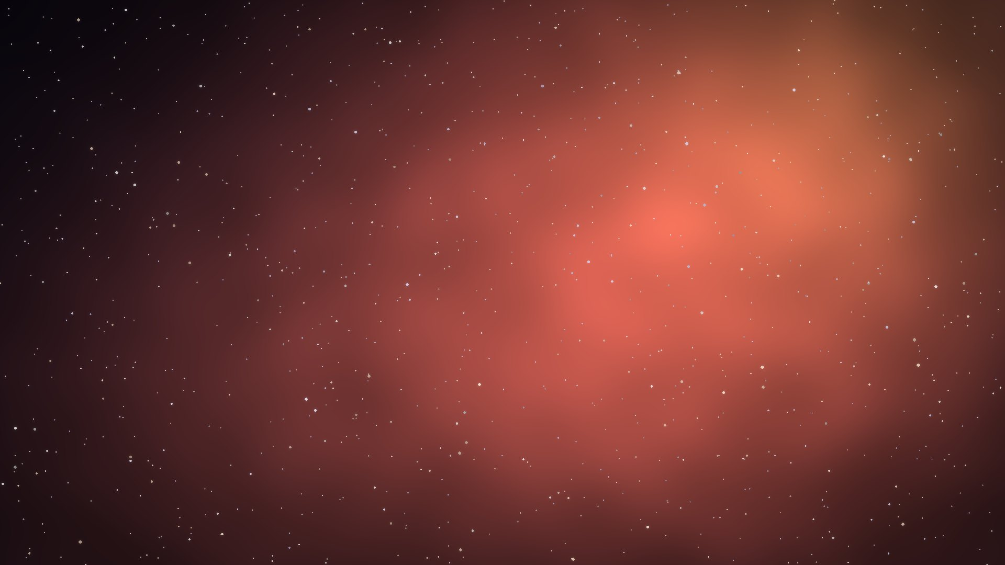

Emberheart Caldera
DAY 1 · HOUR 2
Heart & blood + lungs
Boss: The Cinder Wyrm
You leave able to…
Recite blood flow through the heart; explain acidosis vs alkalosis
♪ Music on / off
⌂ Realm map
Notes:
Hour 2 (Day 1): Heart & blood + lungs. Plan: 45 minutes teaching, 10 minutes quiz or game realm (Emberheart Caldera), 5 minutes break. Goal: Recite blood flow through the heart; explain acidosis vs alkalosis.

Slide 18
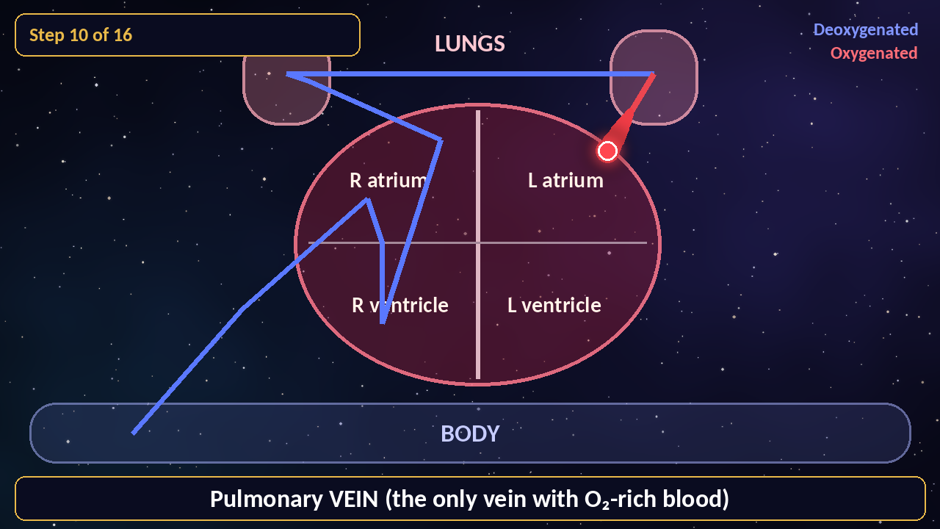
Blood flow: watch the journey
Watch for
Blue = low O₂, red = high O₂.
The right side pumps to the LUNGS.
The left side pumps to the BODY.
Pulmonary ARTERY = deoxygenated.
Pulmonary VEIN = oxygenated.
The video plays automatically. Click it to pause or resume.
Notes:
Video: animated path of a red blood cell through the heart (about 24 seconds). Ask students to say each step out loud with the video. Click the video to pause.

Slide 19
Blood flow: memorize this order
Body
Vena cava
R atrium
Tricuspid
R ventricle
Pulmonary valve
Pulmonary artery
LUNGS
Pulmonary vein
L atrium
Mitral
L ventricle
Aortic valve
Aorta
Body
Valves in order
"Try Pulling My Aorta": Tricuspid, Pulmonary, Mitral, Aortic
Trick question
Pulmonary artery = deoxygenated. Pulmonary vein = oxygenated.
Notes:
Ordered-response practice: have the class call out the next step before each click. Valves: Try Pulling My Aorta.

Slide 20
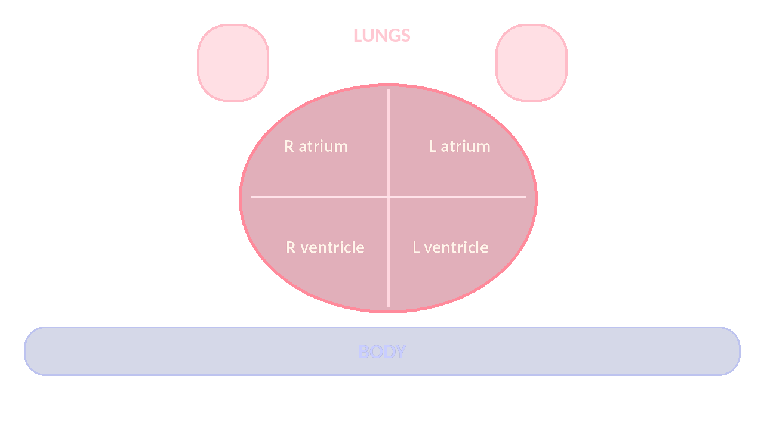
Heart must-knows
Arteries go Away from the heart. Veins return.
Left ventricle = thickest wall (pumps to the whole body).
SA node = pacemaker. Capillaries = exchange (1 cell thick).
Nursing link LEFT heart failure → fluid in the LUNGS. RIGHT heart failure → swollen legs.
Notes:
Arteries carry blood away from the heart. LV has the thickest wall. SA node = pacemaker. Nursing link: left heart failure backs up into the lungs; right heart failure causes swollen legs.

Slide 21




What blood carries, and blood pressure
RBC
Carry O₂ (hemoglobin, iron)
WBC
Fight infection
Platelets
Clotting
Plasma
55%, mostly water
< 120/80
Normal blood pressure
Systolic vs diastolic
Systolic = squeeze (top number, ventricles contract).
Diastolic = relax (bottom number, heart refills).
Notes:
RBC = O2 (hemoglobin, iron), WBC = infection, platelets = clotting, plasma = 55% mostly water. BP normal < 120/80; systolic = squeeze, diastolic = relax.

Slide 22
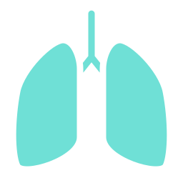

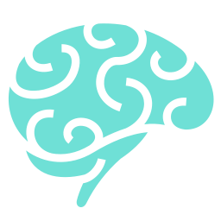

Lungs: the air path
Nose
Pharynx
Larynx
Trachea
Bronchi
Bronchioles
Alveoli
"Please Let The Breath Be Air" = pharynx, larynx, trachea, bronchi, bronchioles, alveoli
Alveoli
Gas exchange by diffusion.
Diaphragm
Contracts DOWN → air rushes IN.
CO₂ drives breathing
Sensed by the medulla.
Epiglottis
The lid that keeps food out of the airway.
Lobes
Right lung 3, left lung 2 (room for the heart).
Notes:
Air path: nose → pharynx → larynx → trachea → bronchi → bronchioles → alveoli. Mnemonic: Please Let The Breath Be Air.

Slide 23
Breathing and blood pH
0
1
2
3
4
5
6
7
8
9
10
11
12
13
14
Normal blood pH 7.35 – 7.45
Click each card to reveal what happens
SLOW breathing
FAST breathing
CO₂ builds up → ACIDOSIS (pH below 7.35)
Blows off CO₂ → ALKALOSIS (pH above 7.45)
Nursing link Normal blood pH = 7.35–7.45. Below = acidosis, above = alkalosis.
Notes:
Interactive: click SLOW or FAST to reveal the outcome. Slow breathing keeps CO2 (acidosis); fast breathing blows it off (alkalosis).

Slide 24
Boss battle · Hour 2 · Question 1 of 3
Emberheart Caldera vs The Cinder Wyrm
Q4. Blood leaving the right ventricle goes next to the:
A Aorta
B Pulmonary artery
✗ Try again
✓ Correct
C Left atrium
D Vena cava
✗ Try again
✗ Try again
✓ Correct! B: Pulmonary artery
Right ventricle → pulmonary artery → lungs
Notes:
Interactive question: click an answer card in Slide Show. A wrong card shows "Try again" with a buzz; the right card rings and reveals the explanation. Answer: B (Pulmonary artery). Why: Right ventricle → pulmonary artery → lungs. Tip: ask students to vote with fingers (1-4) before you click.

Slide 25
Boss battle · Hour 2 · Question 2 of 3
Emberheart Caldera vs The Cinder Wyrm
Q5. Which vessel carries oxygenated blood?
A Pulmonary artery
B Vena cava
✗ Try again
✗ Try again
C Pulmonary vein
D Right ventricle
✓ Correct
✗ Try again
✓ Correct! C: Pulmonary vein
Pulmonary veins bring O₂-rich blood from the lungs
Notes:
Interactive question: click an answer card in Slide Show. A wrong card shows "Try again" with a buzz; the right card rings and reveals the explanation. Answer: C (Pulmonary vein). Why: Pulmonary veins bring O₂-rich blood from the lungs. Tip: ask students to vote with fingers (1-4) before you click.

Slide 26
Boss battle · Hour 2 · Question 3 of 3
Emberheart Caldera vs The Cinder Wyrm
Q6. A patient breathing very fast will most likely develop:
A Respiratory acidosis
B Respiratory alkalosis
✗ Try again
✓ Correct
C Metabolic acidosis
D No change
✗ Try again
✗ Try again
✓ Correct! B: Respiratory alkalosis
Fast breathing blows off CO₂ → pH rises
Notes:
Interactive question: click an answer card in Slide Show. A wrong card shows "Try again" with a buzz; the right card rings and reveals the explanation. Answer: B (Respiratory alkalosis). Why: Fast breathing blows off CO₂ → pH rises. Tip: ask students to vote with fingers (1-4) before you click.

Slide 27
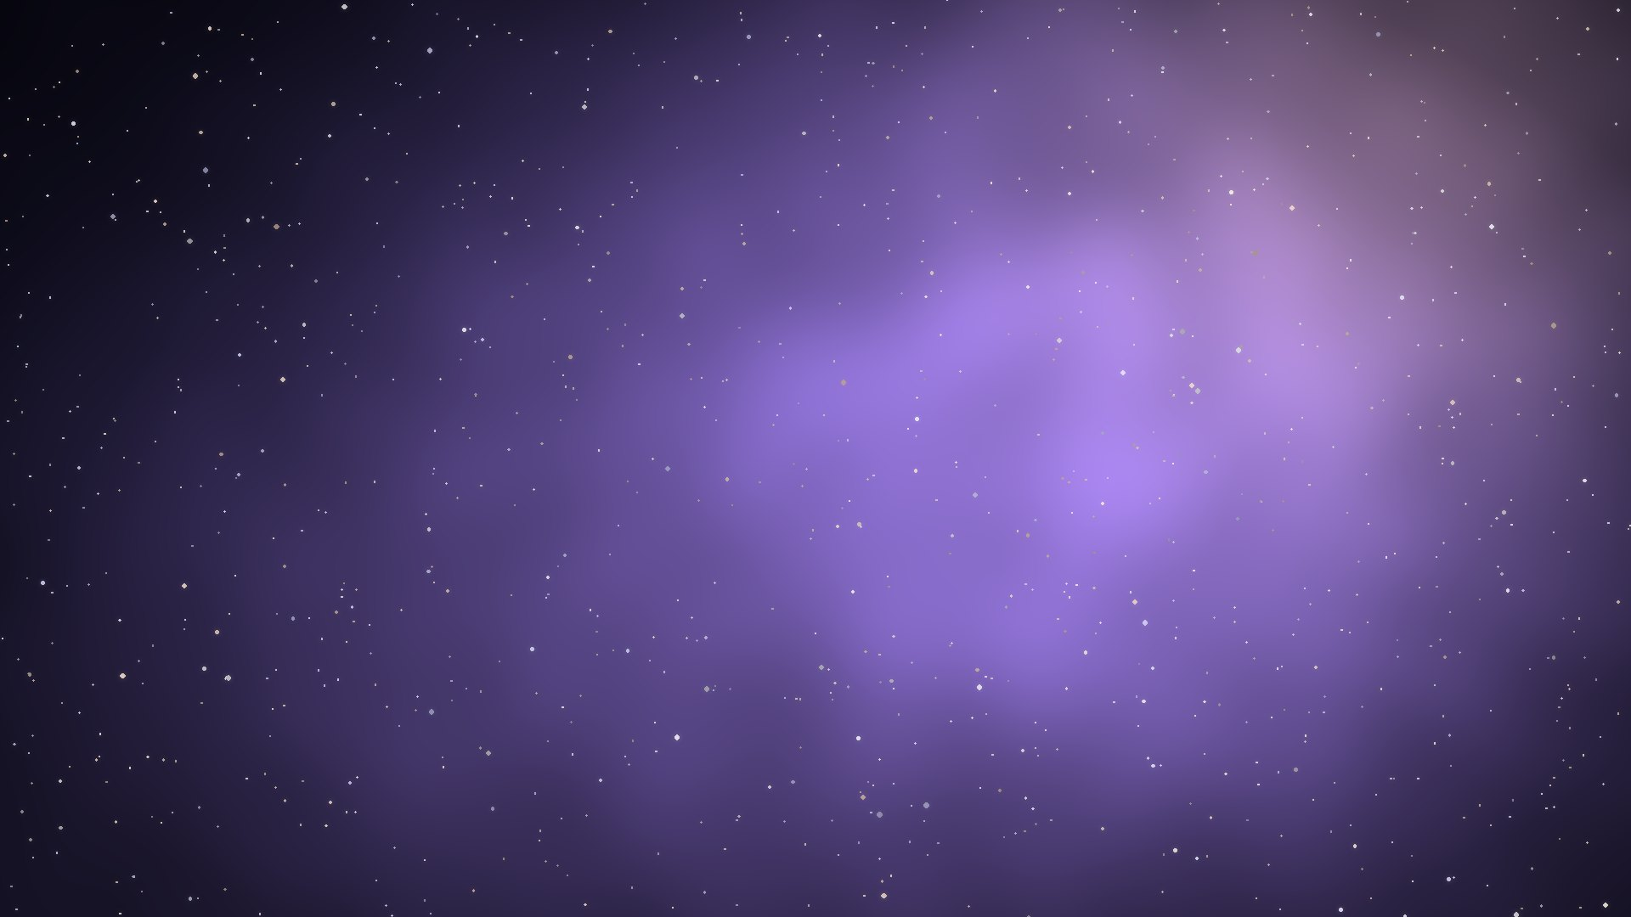

Stormspire Nexus
DAY 1 · HOUR 3
Nervous + endocrine
Boss: The Synapse Tyrant
You leave able to…
Compare sympathetic vs parasympathetic; match glands to hormones
♪ Music on / off
⌂ Realm map
Notes:
Hour 3 (Day 1): Nervous + endocrine. Plan: 45 minutes teaching, 10 minutes quiz or game realm (Stormspire Nexus), 5 minutes break. Goal: Compare sympathetic vs parasympathetic; match glands to hormones.

Slide 28


Nervous system: two speeds
CNS = brain + spinal cord. PNS = all other nerves.
Sympathetic = FIGHT or FLIGHT
↑ heart rate, ↑ blood pressure
Big pupils, open airways
Digestion STOPS
Parasympathetic = REST and DIGEST
↓ heart rate
Digestion ON
Vagus nerve
Nursing link Left-brain stroke → RIGHT-side weakness (the brain controls the opposite side).
Notes:
Sympathetic = fight or flight (↑HR, ↑BP, big pupils, digestion stops). Parasympathetic = rest and digest (↓HR, digestion on, vagus nerve).

Slide 29
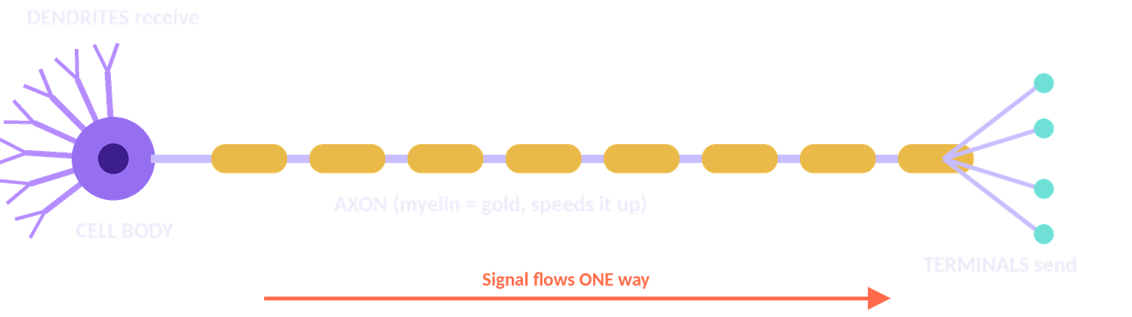
The neuron and the brain map
"Don't Call Again"
Dendrite → Cell body → Axon. Myelin speeds the signal up.
Cerebrum
Thinking
Cerebellum
Balance
SAME
Sensory = Afferent (to the brain)
Motor = Efferent (away)
Medulla
Breathing + heart rate
Hypothalamus
Temperature, thirst; controls the pituitary
Notes:
Signal flows one way: dendrite → cell body → axon ("Don't Call Again"). SAME: Sensory Afferent, Motor Efferent. Cerebellum = balance; medulla = breathing and heart rate.

Slide 30
Endocrine: gland → hormone
Gland | Remember
Hypothalamus | MAKES ADH + oxytocin; bosses the pituitary
Anterior pituitary | "Master gland": GH, TSH, ACTH, FSH, LH, prolactin
Posterior pituitary | STORES/RELEASES ADH + oxytocin
Thyroid | T3/T4 = metabolism. CalciTONIN TONES DOWN calcium
Parathyroid | PTH PULLS calcium UP from bone
Adrenal cortex | Cortisol (stress, sugar), aldosterone (keep salt)
Adrenal medulla | Epinephrine = adrenaline
Pancreas | Insulin lowers sugar (lets it IN to cells); glucagon raises it ("glucose gone" → make more)
Nursing link Type 1 diabetes = no insulin. Type 2 = insulin doesn't work well.
Notes:
Most hormones are controlled by negative feedback. Steroid hormones (cortisol, estrogen, testosterone) are made from cholesterol.

Slide 31
Mnemonic vault: click to unlock
🔒 "Calcitonin tones down"
🔒 "PTH pulls up"
🔒 "Insulin lets it IN"
Calcitonin LOWERS blood calcium
Parathyroid hormone RAISES calcium (from bone)
Insulin moves glucose into cells → sugar falls
🔒 "Glucose gone → make more"
🔒 Made from cholesterol
🔒 Most hormones…
Glucagon RAISES blood sugar
Steroid hormones: cortisol, estrogen, testosterone
…are controlled by NEGATIVE feedback
Notes:
Interactive: ask the class what each cue means, then click the locked card to reveal the answer.

Slide 32
Boss battle · Hour 3 · Question 1 of 3
Stormspire Nexus vs The Synapse Tyrant
Q7. Which response is sympathetic?
A Slower heart rate
B Increased digestion
✗ Try again
✗ Try again
C Dilated pupils
D Constricted bronchioles
✓ Correct
✗ Try again
✓ Correct! C: Dilated pupils
Fight or flight: big pupils
Notes:
Interactive question: click an answer card in Slide Show. A wrong card shows "Try again" with a buzz; the right card rings and reveals the explanation. Answer: C (Dilated pupils). Why: Fight or flight: big pupils. Tip: ask students to vote with fingers (1-4) before you click.

Slide 33
Boss battle · Hour 3 · Question 2 of 3
Stormspire Nexus vs The Synapse Tyrant
Q8. ADH is made in the ___ and released from the ___.
A Pituitary, hypothalamus
B Hypothalamus, posterior pituitary
✗ Try again
✓ Correct
C Kidney, adrenal
D Thyroid, parathyroid
✗ Try again
✗ Try again
✓ Correct! B: Hypothalamus, posterior pituitary
Hypothalamus makes, posterior pituitary releases
Notes:
Interactive question: click an answer card in Slide Show. A wrong card shows "Try again" with a buzz; the right card rings and reveals the explanation. Answer: B (Hypothalamus, posterior pituitary). Why: Hypothalamus makes, posterior pituitary releases. Tip: ask students to vote with fingers (1-4) before you click.

Slide 34
Boss battle · Hour 3 · Question 3 of 3
Stormspire Nexus vs The Synapse Tyrant
Q9. Which hormone raises blood calcium?
A Calcitonin
B Insulin
✗ Try again
✗ Try again
C Parathyroid hormone
D Aldosterone
✓ Correct
✗ Try again
✓ Correct! C: Parathyroid hormone
PTH pulls calcium up
Notes:
Interactive question: click an answer card in Slide Show. A wrong card shows "Try again" with a buzz; the right card rings and reveals the explanation. Answer: C (Parathyroid hormone). Why: PTH pulls calcium up. Tip: ask students to vote with fingers (1-4) before you click.

Slide 35
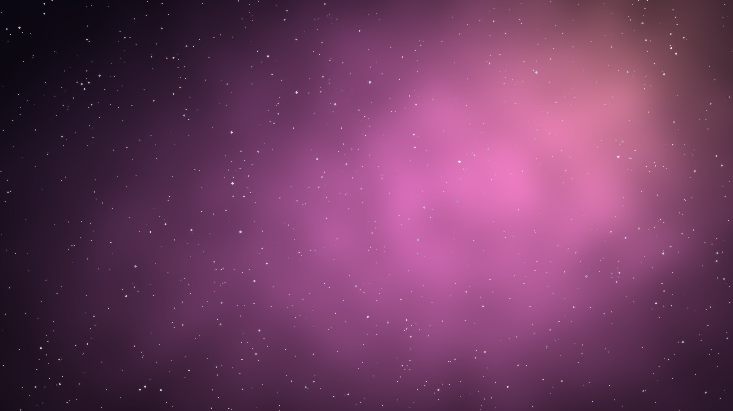

The Gumdrop Gut Works
DAY 1 · HOUR 4
Digestive + urinary
Boss: The Sugar Baron
You leave able to…
Trace food and urine; explain ADH and aldosterone
♪ Music on / off
⌂ Realm map
Notes:
Hour 4 (Day 1): Digestive + urinary. Plan: 45 minutes teaching, 10 minutes quiz or game realm (The Gumdrop Gut Works), 5 minutes break. Goal: Trace food and urine; explain ADH and aldosterone.

Slide 36
Digestive system: the food path
Mouth
Esophagus
Stomach
Small intestine
Large intestine
Rectum
Small intestine: Duodenum, Jejunum, Ileum = "Dow Jones Industrial"
Mouth
Amylase starts CARBS.
Stomach
Acid + pepsin start PROTEIN.
Liver & gallbladder
Liver MAKES bile; gallbladder STORES it. Bile emulsifies fat (not an enzyme).
Pancreas
Sends enzymes for all three: amylase, lipase, trypsin.
Small intestine
Absorbs nutrients (villi).
Large intestine
Absorbs WATER.
Nursing link RUQ pain after fatty food → think gallbladder. RLQ pain → think appendix.
Notes:
Food path: mouth → esophagus → stomach → small intestine (Dow Jones Industrial) → large intestine → rectum.

Slide 37
Urinary system: the kidney crew
Kidney
Ureter
Bladder
Urethra
"Kids Use Big Umbrellas"
The nephron (filtering unit): "Filter, Reclaim, Spit, Exit"
Filter (glomerulus)
Reabsorb
Secrete
Excrete
ADH
Anti-Diuretic = HOLDS WATER → less urine. Alcohol blocks ADH → you pee more.
Aldosterone
Holds SALT (and water follows) → ↑ blood pressure.
Kidneys also make
EPO (→ red blood cells) and renin (→ raises BP).
Nursing link Glucose or protein in urine = abnormal. Kidney failure → high BP + anemia.
Notes:
ADH holds water; aldosterone holds salt. Kidneys make EPO and renin, so kidney failure causes anemia and high blood pressure.

Slide 38
Boss battle · Hour 4 · Question 1 of 3
The Gumdrop Gut Works vs The Sugar Baron
Q10. Where does protein digestion begin?
A Mouth
B Stomach
✗ Try again
✓ Correct
C Small intestine
D Large intestine
✗ Try again
✗ Try again
✓ Correct! B: Stomach
Pepsin + acid in the stomach
Notes:
Interactive question: click an answer card in Slide Show. A wrong card shows "Try again" with a buzz; the right card rings and reveals the explanation. Answer: B (Stomach). Why: Pepsin + acid in the stomach. Tip: ask students to vote with fingers (1-4) before you click.

Slide 39
Boss battle · Hour 4 · Question 2 of 3
The Gumdrop Gut Works vs The Sugar Baron
Q11. Bile is made by the ___ and stored by the ___.
A Gallbladder, liver
B Pancreas, liver
✗ Try again
✗ Try again
C Liver, gallbladder
D Stomach, pancreas
✓ Correct
✗ Try again
✓ Correct! C: Liver, gallbladder
Liver makes, gallbladder stores
Notes:
Interactive question: click an answer card in Slide Show. A wrong card shows "Try again" with a buzz; the right card rings and reveals the explanation. Answer: C (Liver, gallbladder). Why: Liver makes, gallbladder stores. Tip: ask students to vote with fingers (1-4) before you click.

Slide 40
Boss battle · Hour 4 · Question 3 of 3
The Gumdrop Gut Works vs The Sugar Baron
Q12. Where does blood filtration occur in the kidney?
A Loop of Henle
B Collecting duct
✗ Try again
✗ Try again
C Glomerulus
D Ureter
✓ Correct
✗ Try again
✓ Correct! C: Glomerulus
Filtering happens at the glomerulus
Notes:
Interactive question: click an answer card in Slide Show. A wrong card shows "Try again" with a buzz; the right card rings and reveals the explanation. Answer: C (Glomerulus). Why: Filtering happens at the glomerulus. Tip: ask students to vote with fingers (1-4) before you click.

Slide 41

Day 1 cleared!
Four realms conquered: foundations, heart & lungs, nervous & endocrine, digestive & urinary.
Notes:
Celebrate! Remind students to finish realms 1-4 in the game and lock in their finals before Day 2.

Slide 42
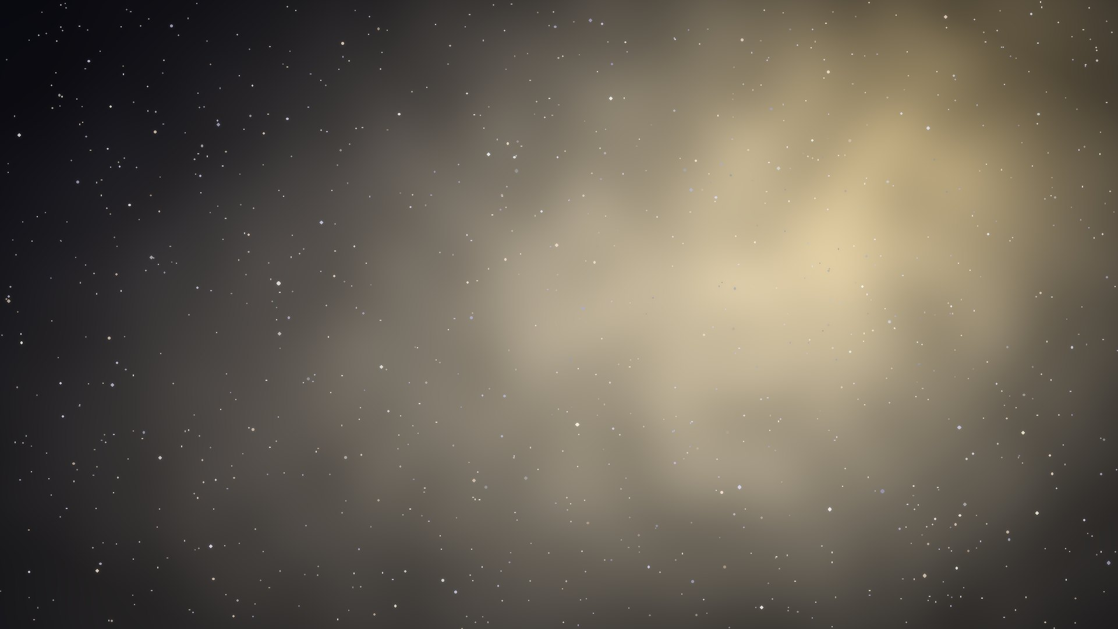

The Rattling Gymnasium
DAY 2 · HOUR 5
Bones, muscles, skin
Boss: Sir Rattlebones
You leave able to…
Explain blast vs clast, muscle types, skin layers and glands
♪ Music on / off
⌂ Realm map
Notes:
Hour 5 (Day 2): Bones, muscles, skin. Plan: 45 minutes teaching, 10 minutes quiz or game realm (The Rattling Gymnasium), 5 minutes break. Goal: Explain blast vs clast, muscle types, skin layers and glands.

Slide 43
Day 2 warm-up: 5-minute rapid recall
1. Blood flow through the heart
RA → tricuspid → RV → pulmonary artery → lungs → pulmonary vein → LA → mitral → LV → aorta
2. Gland → hormone pairs
Pancreas: insulin/glucagon · Thyroid: T3/T4, calcitonin · Parathyroid: PTH · Adrenal: cortisol, aldosterone, epinephrine
3. The food path
Mouth → esophagus → stomach → small intestine → large intestine → rectum
4. The urine path
Kidney → ureter → bladder → urethra
Students answer out loud, then click the gold card to check.
Notes:
First 5 minutes of Hour 5: rapid recall of Day 1. Click each gold prompt to reveal the answer after students respond.

Slide 44
Skeletal system
206
bones in the adult body
Jobs
Support, protect, move, store calcium, make blood cells (red marrow).
Blast = Build. Clast = Crush. Osteoblasts build bone; osteoclasts break it down.
Long: femur
Short: wrist, ankle
Flat: skull, ribs, sternum
Irregular: vertebrae, pelvis
Sesamoid: kneecap
Ligament = bone to bone ("Link"). Tendon = muscle to bone ("Tug").
"Breakfast at 7, lunch at 12, dinner at 5" = cervical, thoracic, lumbar vertebrae.
Nursing link Osteoporosis = clasts beat blasts → fragile bones. Risk: menopause (low estrogen), low calcium/vitamin D, inactivity.
Notes:
206 bones. Blast = build, clast = crush. Ligament links bone to bone; tendon tugs muscle to bone. Vertebrae 7-12-5.

Slide 45
Muscular system
Type | Control | Striped? | Where
Skeletal | Voluntary | Yes | Bones
Cardiac | Involuntary | Yes | Heart only
Smooth | Involuntary | No | Organs, vessels
Contraction, step by step (needs ATP)
1. Nerve signal
2. Calcium released
3. Myosin grabs actin and pulls
Muscles work in pairs
Biceps bends; triceps straightens.
4. Muscle shortens
ABduction = ABducted AWAY from the midline. ADDuction = ADD back to the body.
Notes:
Have students abduct and adduct their arms. Contraction: nerve signal → calcium → myosin grabs actin and pulls → shortens; needs ATP.

Slide 46
Skin: the integumentary system
Epidermis
No blood vessels; melanin, keratin
Jobs
Barrier, temperature control, sensation, MAKES VITAMIN D.
Dermis
Vessels, nerves, glands, hair
Eccrine = Everyday cooling sweat
Apocrine = Armpit/groin; body odor (after puberty)
Hypodermis
Fat
Sebaceous = Sebum (oil)
Nursing link Turn bedbound patients every 2 hours to prevent pressure injuries.
Notes:
Layers top to bottom: epidermis (no blood vessels), dermis (vessels, nerves, glands, hair), hypodermis (fat). Glands: eccrine, apocrine, sebaceous.

Slide 47
Boss battle · Hour 5 · Question 1 of 3
The Rattling Gymnasium vs Sir Rattlebones
Q13. Which cell breaks down bone?
A Osteoblast
B Osteoclast
✗ Try again
✓ Correct
C Osteocyte
D Chondrocyte
✗ Try again
✗ Try again
✓ Correct! B: Osteoclast
Clast = crush
Notes:
Interactive question: click an answer card in Slide Show. A wrong card shows "Try again" with a buzz; the right card rings and reveals the explanation. Answer: B (Osteoclast). Why: Clast = crush. Tip: ask students to vote with fingers (1-4) before you click.

Slide 48
Boss battle · Hour 5 · Question 2 of 3
The Rattling Gymnasium vs Sir Rattlebones
Q14. Muscle is attached to bone by:
A Ligaments
B Cartilage
✗ Try again
✗ Try again
C Tendons
D Fascia
✓ Correct
✗ Try again
✓ Correct! C: Tendons
Tendon = tug
Notes:
Interactive question: click an answer card in Slide Show. A wrong card shows "Try again" with a buzz; the right card rings and reveals the explanation. Answer: C (Tendons). Why: Tendon = tug. Tip: ask students to vote with fingers (1-4) before you click.

Slide 49
Boss battle · Hour 5 · Question 3 of 3
The Rattling Gymnasium vs Sir Rattlebones
Q15. Which gland produces sebum?
A Eccrine
B Apocrine
✗ Try again
✗ Try again
C Sebaceous
D Thyroid
✓ Correct
✗ Try again
✓ Correct! C: Sebaceous
Sebaceous = sebum
Notes:
Interactive question: click an answer card in Slide Show. A wrong card shows "Try again" with a buzz; the right card rings and reveals the explanation. Answer: C (Sebaceous). Why: Sebaceous = sebum. Tip: ask students to vote with fingers (1-4) before you click.

Slide 50


Bastion of Wards
DAY 2 · HOUR 6
Immune/lymphatic + reproductive
Boss: The Germ Overlord
You leave able to…
Fill in the active/passive immunity grid; name antibody types
♪ Music on / off
⌂ Realm map
Notes:
Hour 6 (Day 2): Immune/lymphatic + reproductive. Plan: 45 minutes teaching, 10 minutes quiz or game realm (Bastion of Wards), 5 minutes break. Goal: Fill in the active/passive immunity grid; name antibody types.

Slide 51
Immune & lymphatic defenses
Lymphatic: returns fluid to blood; lymph nodes filter; SPLEEN filters blood; THYMUS trains T cells.
Innate (born with, nonspecific)
Skin, mucus, stomach acid, fever, inflammation, phagocytes.
Adaptive (learned, specific, has memory)
B cells → antibodies. T cells → kill infected cells.
You MAKE the antibodies (lasts long)
You are GIVEN antibodies (short-term)
Active: ?
Active: You catch the disease
Passive: ?
Natural
Passive: Mom → baby (placenta, breast milk)
Active: ?
Active: Vaccine
Passive: ?
Artificial
Passive: Antibody shot
Click each "?" to fill the grid. Hook: ACTIVE = your body does the work. PASSIVE = borrowed.
Notes:
Interactive grid: click each "?" to reveal it. Natural active = catch the disease; natural passive = mom to baby; artificial active = vaccine; artificial passive = antibody shot.

Slide 52
Antibodies: think "G-A-M-E"
IgG
Most common; crosses the placenta
"Gestation"
IgA
Tears, saliva, breast milk
"A" for secretions
IgM
First responder
"Main first"
IgE
Allergies
"Eek!"
Nursing link HIV attacks helper T cells → frequent infections.
Notes:
IgG = most common, crosses the placenta (Gestation). IgA = tears, saliva, breast milk. IgM = first responder (Main first). IgE = allergies (Eek!).

Slide 53
Reproductive system
Male path
Testes: sperm + testosterone
Epididymis (matures)
Vas deferens
Urethra
Female path
Ovaries: eggs + estrogen/progesterone
Fertilization in the FALLOPIAN TUBE
Implants in the uterus
LH surge
→ ovulation (about day 14).
Progesterone
"Pro-gestation": keeps the uterine lining.
Meiosis
Gametes have 23 chromosomes. Egg + sperm → 46.
Nursing link Embryo implanted in the fallopian tube = ECTOPIC pregnancy (emergency).
Notes:
Testosterone is the main androgen. Fertilization happens in the fallopian tube. LH surge triggers ovulation around day 14.

Slide 54
Boss battle · Hour 6 · Question 1 of 3
Bastion of Wards vs The Germ Overlord
Q16. A baby receiving antibodies through breast milk is an example of:
A Natural active
B Artificial active
✗ Try again
✗ Try again
C Natural passive
D Artificial passive
✓ Correct
✗ Try again
✓ Correct! C: Natural passive
Borrowed from mom = natural passive
Notes:
Interactive question: click an answer card in Slide Show. A wrong card shows "Try again" with a buzz; the right card rings and reveals the explanation. Answer: C (Natural passive). Why: Borrowed from mom = natural passive. Tip: ask students to vote with fingers (1-4) before you click.

Slide 55
Boss battle · Hour 6 · Question 2 of 3
Bastion of Wards vs The Germ Overlord
Q17. Which cells make antibodies?
A T cells
B B cells
✗ Try again
✓ Correct
C Neutrophils
D Platelets
✗ Try again
✗ Try again
✓ Correct! B: B cells
B cells → antibodies
Notes:
Interactive question: click an answer card in Slide Show. A wrong card shows "Try again" with a buzz; the right card rings and reveals the explanation. Answer: B (B cells). Why: B cells → antibodies. Tip: ask students to vote with fingers (1-4) before you click.

Slide 56
Boss battle · Hour 6 · Question 3 of 3
Bastion of Wards vs The Germ Overlord
Q18. Fertilization usually happens in the:
A Uterus
B Ovary
✗ Try again
✗ Try again
C Fallopian tube
D Cervix
✓ Correct
✗ Try again
✓ Correct! C: Fallopian tube
Fallopian tube
Notes:
Interactive question: click an answer card in Slide Show. A wrong card shows "Try again" with a buzz; the right card rings and reveals the explanation. Answer: C (Fallopian tube). Why: Fallopian tube. Tip: ask students to vote with fingers (1-4) before you click.

Slide 57
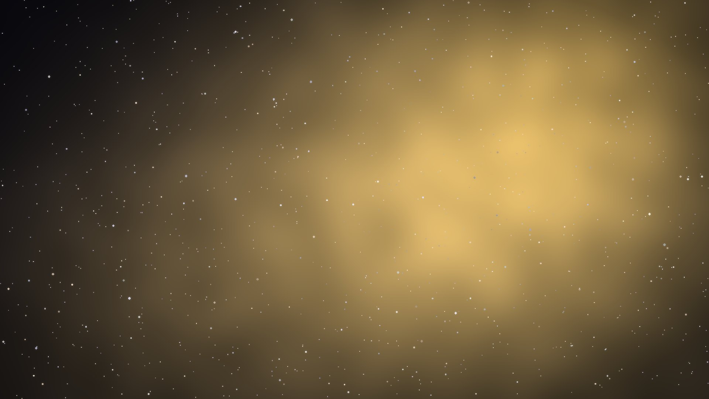

The Mad Alchemist's Lab
DAY 2 · HOUR 7
Biology + chemistry
Boss: Professor Fizzwick
You leave able to…
Match organelles; do a Punnett square; read pH; name reaction types
♪ Music on / off
⌂ Realm map
Notes:
Hour 7 (Day 2): Biology + chemistry. Plan: 45 minutes teaching, 10 minutes quiz or game realm (The Mad Alchemist's Lab), 5 minutes break. Goal: Match organelles; do a Punnett square; read pH; name reaction types.

Slide 58
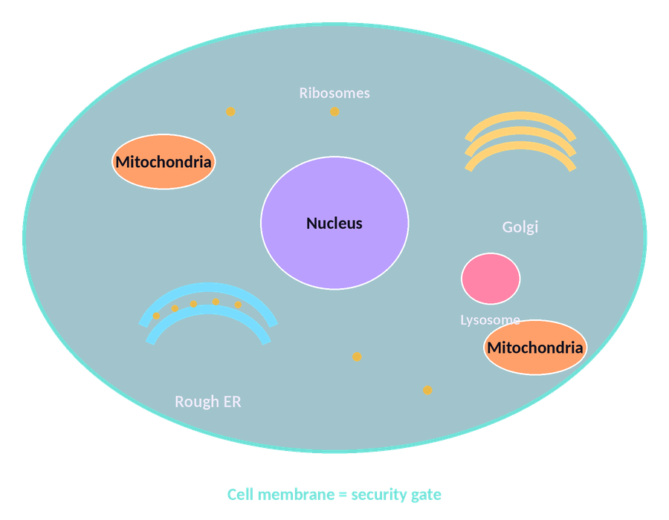
The cell is a factory
Organelle | Job | Factory role
Nucleus | Holds DNA | Boss's office
Mitochondria | Makes ATP (cellular respiration) | Power plant
Ribosomes | Make proteins | Workers
Rough ER | Protein transport (has ribosomes) | Assembly line
Smooth ER | Makes lipids, detox | Chemical shop
Golgi | Packages and ships proteins | Shipping office
Lysosome | Breaks down waste | Clean-up crew
Cell membrane | Controls what enters/leaves | Security gate
Cytoskeleton | Shape and movement (protein) | Building frame
Plant cells also have a cell wall, chloroplasts and a big central vacuole.
Notes:
Factory analogy: nucleus = boss, mitochondria = power plant (ATP), ribosomes = workers (proteins), Golgi = shipping.

Slide 59
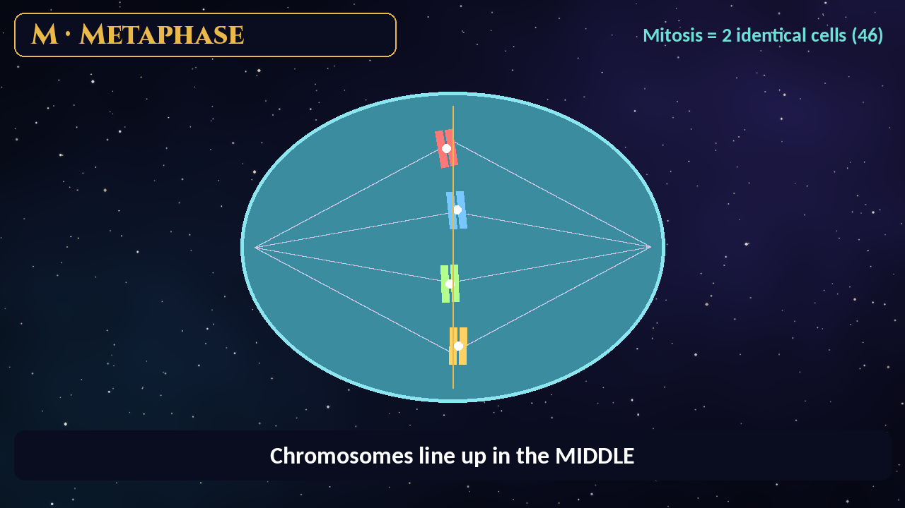
Mitosis vs meiosis
Mitosis
2 IDENTICAL body cells, diploid (46)
Growth and repair
PMAT: Prophase, Metaphase (Middle), Anaphase (Apart), Telophase (Two nuclei)
Meiosis
4 UNIQUE sex cells, haploid (23). "Mei-Osis makes Ova."
The PMAT video plays automatically. Click it to pause or resume.
P
M
A
T
Notes:
Video shows PMAT: Prophase (condense), Metaphase (middle), Anaphase (apart), Telophase (two nuclei). Mitosis makes 2 identical cells; meiosis makes 4 unique sex cells.

Slide 60
DNA → RNA → protein
A
T
C
G
RNA swaps T for U
In RNA, A pairs with U (A–U).
"Apple in the Tree"
"Car in the Garage"
DNA
mRNA
Protein
Transcription (in the nucleus)
Translation (at the ribosome)
DNA = double helix, deoxyribose. RNA = single strand, ribose.
Notes:
DNA pairs A–T, C–G; RNA uses U instead of T. Transcription DNA → mRNA in the nucleus; translation mRNA → protein at the ribosome.

Slide 61
Genetics: the Punnett square
B
b
1 BB : 2 Bb : 1 bb
→ 3 : 1 dominant to recessive look (75% / 25%)
B
?
BB
?
Bb
Dominant = capital (B); recessive = lowercase (b). Recessive shows only as bb.
Genotype = the letters. Phenotype = what you see.
b
?
Bb
?
bb
Codominance = both show (AB blood).
Incomplete dominance = blend (red × white = pink).
Bb × Bb (click each "?")
Notes:
Interactive: click each "?" in the Punnett square. Bb × Bb gives 1 BB : 2 Bb : 1 bb, a 3:1 dominant-to-recessive look (75%/25%).

Slide 62




Macromolecules: "CLiP N"
C · Carbohydrates
Built from: Monosaccharides (glucose)
Job: Quick energy
Li · Lipids
Built from: Fatty acids + glycerol
Job: Long-term energy, membranes, hormones
P · Proteins
Built from: Amino acids
Job: Enzymes, structure, antibodies
N · Nucleic acids
Built from: Nucleotides
Job: DNA/RNA (genetic info)
Microorganisms
Bacteria (no nucleus; treated with antibiotics) · Viruses (not cells; need a host; antibiotics don't work) · Fungi (yeast, mold) · Protozoa (malaria parasite)
Notes:
CLiP N: Carbohydrates, Lipids, Proteins, Nucleic acids. Antibiotics do not work on viruses.

Slide 63
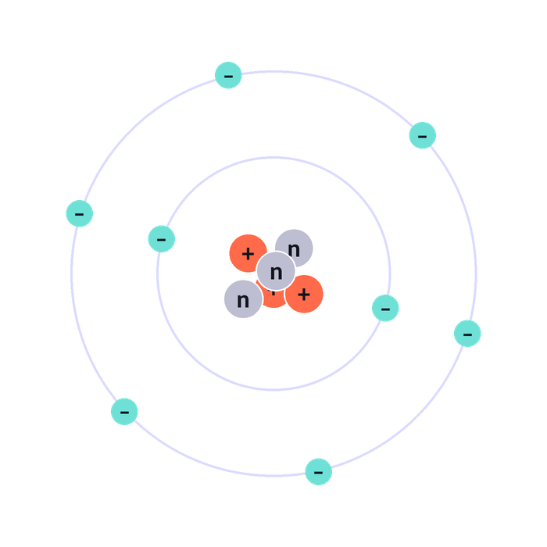
The atom: "PEN"
P Protons = Positive, in the nucleus. Atomic number = # of protons (identifies the element).
E Electrons = negative, orbit the nucleus. Neutral atom: electrons = protons.
N Neutrons = Neutral, in the nucleus. Mass number = protons + neutrons.
Isotope = same protons, different neutrons. Ion = gained/lost electrons. Valence electrons = outer shell; decide bonding.
Notes:
PEN: Protons positive, Electrons negative, Neutrons neutral. Atomic number = protons.

Slide 64
Bonds & reaction types
Ionic = electrons GIVEN
Metal + nonmetal (NaCl). "Ionic = I give."
Type | Pattern | Hook
Synthesis | A + B → AB | Marriage
Decomposition | AB → A + B | Divorce
Single replacement | A + BC → AC + B | Someone cuts in on the dance
Double replacement | AB + CD → AD + CB | Partner swap
Combustion | Fuel + O₂ → CO₂ + H₂O | Fire
Covalent = electrons SHARED
Nonmetal + nonmetal (H₂O). "Co = cooperate."
Hydrogen bonds
Weak attractions between water molecules (high surface tension, boiling point).
Balancing: same number of each atom on both sides; change only the coefficients.
Catalyst/enzyme: speeds a reaction by lowering activation energy; not used up.
Electronegativity
Rises UP and to the RIGHT on the periodic table (fluorine highest).
Notes:
Ionic = I give; covalent = cooperate (share). Reaction hooks: marriage, divorce, cut in on the dance, partner swap, fire.

Slide 65
pH, solutions & states of matter
0
1
2
3
4
5
6
7
8
9
10
11
12
13
14
ACID (more H⁺)
7 = NEUTRAL (water)
BASE (more OH⁻)
Each step = 10×. pH 3 is 10× more acidic than pH 4.
"Acids Are low; Bases are Big numbers."
Solute (dissolved, e.g. salt) + solvent (does the dissolving, e.g. water) = solution. Water = the "universal solvent."
Solid → liquid = Melting
Liquid → gas = Vaporization
Gas → liquid = Condensation
Liquid → solid = Freezing
Solid → gas = Sublimation (dry ice)
Gas → solid = Deposition (frost)
Triple point = solid, liquid and gas coexist. Critical point = liquid and gas become indistinguishable.
Notes:
pH 0–14: below 7 acid, 7 neutral, above 7 base; each step is 10×.

Slide 66
Boss battle · Hour 7 · Question 1 of 4
The Mad Alchemist's Lab vs Professor Fizzwick
Q19. Which organelle makes ATP?
A Ribosome
B Golgi
✗ Try again
✗ Try again
C Mitochondria
D Lysosome
✓ Correct
✗ Try again
✓ Correct! C: Mitochondria
Power plant
Notes:
Interactive question: click an answer card in Slide Show. A wrong card shows "Try again" with a buzz; the right card rings and reveals the explanation. Answer: C (Mitochondria). Why: Power plant. Tip: ask students to vote with fingers (1-4) before you click.

Slide 67
Boss battle · Hour 7 · Question 2 of 4
The Mad Alchemist's Lab vs Professor Fizzwick
Q20. Bb × Bb: what percent of offspring show the recessive trait?
A 0%
B 25%
✗ Try again
✓ Correct
C 50%
D 75%
✗ Try again
✗ Try again
✓ Correct! B: 25%
Only bb (1 of 4)
Notes:
Interactive question: click an answer card in Slide Show. A wrong card shows "Try again" with a buzz; the right card rings and reveals the explanation. Answer: B (25%). Why: Only bb (1 of 4). Tip: ask students to vote with fingers (1-4) before you click.

Slide 68
Boss battle · Hour 7 · Question 3 of 4
The Mad Alchemist's Lab vs Professor Fizzwick
Q21. Which particle determines the atomic number?
A Neutron
B Electron
✗ Try again
✗ Try again
C Proton
D Isotope
✓ Correct
✗ Try again
✓ Correct! C: Proton
Protons = atomic number
Notes:
Interactive question: click an answer card in Slide Show. A wrong card shows "Try again" with a buzz; the right card rings and reveals the explanation. Answer: C (Proton). Why: Protons = atomic number. Tip: ask students to vote with fingers (1-4) before you click.

Slide 69
Boss battle · Hour 7 · Question 4 of 4
The Mad Alchemist's Lab vs Professor Fizzwick
Q22. A solution with pH 3 is:
A Basic
B Neutral
✗ Try again
✗ Try again
C Acidic
D A salt
✓ Correct
✗ Try again
✓ Correct! C: Acidic
Below 7 = acid
Notes:
Interactive question: click an answer card in Slide Show. A wrong card shows "Try again" with a buzz; the right card rings and reveals the explanation. Answer: C (Acidic). Why: Below 7 = acid. Tip: ask students to vote with fingers (1-4) before you click.

Slide 70
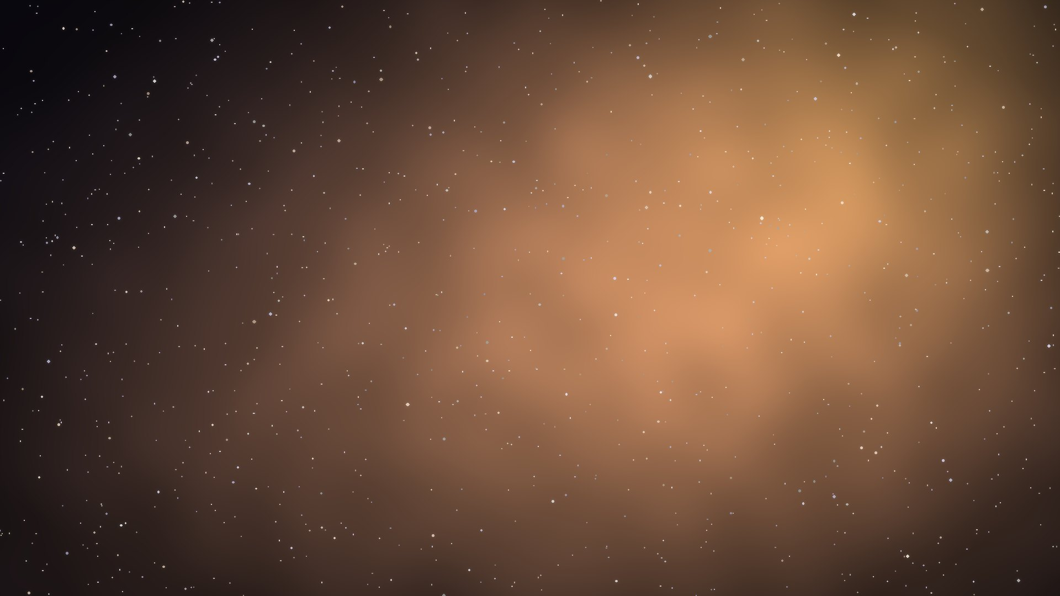

The Sandglass Archive
DAY 2 · HOUR 8
Scientific reasoning + timed quiz + cram sheet
Boss: The Riddling Sphinx
You leave able to…
Identify variables; score 75%+ on the timed quiz
♪ Music on / off
⌂ Realm map
Notes:
Hour 8 (Day 2): Scientific reasoning + timed quiz + cram sheet. Plan: 45 minutes teaching, 10 minutes quiz or game realm (The Sandglass Archive), 5 minutes break. Goal: Identify variables; score 75%+ on the timed quiz.

Slide 71
Scientific method: "Only Quiet Hippos Eat All Cake"
Observe
Question
Hypothesis
Experiment
Analyze
Conclude
Independent = What I change.
Dependent = What I measure (it DEPENDS on the independent).
Control group = Gets no treatment (for comparison).
Constants = Kept the same.
Example: "Does caffeine raise heart rate?"
Caffeine dose = independent. Heart rate = dependent.
Good evidence
Large sample, repeated trials, one variable at a time. Correlation ≠ causation.
Notes:
Observe → Question → Hypothesis → Experiment → Analyze → Conclude. Independent = what I change; dependent = what I measure.

Slide 72
The metric staircase
K kilo
× 1,000
"King Henry Died By Drinking Chocolate Milk"
H hecto
× 100
D deka
× 10
B BASE (m, L, g)
× 1
D deci
× 0.1
C centi
× 0.01
M milli
× 0.001
Move one step = × or ÷ 10
Down the stairs (bigger → smaller unit): multiply. Up the stairs: divide.
Must-knows
1 kg = 1,000 g · 1 L = 1,000 mL · 1 m = 100 cm
Tools: graduated cylinder (volume), balance (mass), thermometer (°C)
Notes:
Practice: 2.5 L = 2,500 mL (three steps down, × 1,000).

Slide 73
Boss battle · Hour 8 · Question 1 of 2
The Sandglass Archive vs The Riddling Sphinx
Q23. Students give plants different amounts of fertilizer and measure height. The dependent variable is:
A Fertilizer amount
B Plant height
✗ Try again
✓ Correct
C Type of plant
D Sunlight
✗ Try again
✗ Try again
✓ Correct! B: Plant height
Height depends on fertilizer
Notes:
Interactive question: click an answer card in Slide Show. A wrong card shows "Try again" with a buzz; the right card rings and reveals the explanation. Answer: B (Plant height). Why: Height depends on fertilizer. Tip: ask students to vote with fingers (1-4) before you click.

Slide 74
Boss battle · Hour 8 · Question 2 of 2
The Sandglass Archive vs The Riddling Sphinx
Q24. How many milliliters are in 2.5 liters?
A 25
B 250
✗ Try again
✗ Try again
C 2,500
D 25,000
✓ Correct
✗ Try again
✓ Correct! C: 2,500
1 L = 1,000 mL
Notes:
Interactive question: click an answer card in Slide Show. A wrong card shows "Try again" with a buzz; the right card rings and reveals the explanation. Answer: C (2,500). Why: 1 L = 1,000 mL. Tip: ask students to vote with fingers (1-4) before you click.

Slide 75

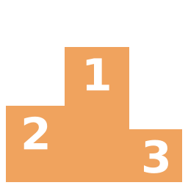

Final boss: the timed practice quiz
24 questions
24 minutes · about 1 minute each
Day 2 · Hour 8
15 min scientific reasoning, 30 min timed quiz, 15 min cram-sheet review.
Goal
Score 75%+ on the quiz.
In the game
Every quiz question in this deck comes from the bootcamp practice quiz; the game has 400 more.
▶ Play Realms of Anatomica
The answer key is on the next two slides.
Notes:
Run all 24 questions timed (24 minutes) in Day 2 Hour 8, or use the interactive boss-battle slides after each hour.

Slide 76
Answer key (1–12)
# | Answer | Why
1 | C · Sagittal | Sagittal = left/right
2 | B · Distal | Farther from where the arm attaches
3 | D · Contractions during labor | Labor amplifies until birth
4 | B · Pulmonary artery | Right ventricle → pulmonary artery → lungs
5 | C · Pulmonary vein | Pulmonary veins bring O₂-rich blood from the lungs
6 | B · Respiratory alkalosis | Fast breathing blows off CO₂ → pH rises
7 | C · Dilated pupils | Fight or flight: big pupils
8 | B · Hypothalamus, posterior pituitary | Hypothalamus makes, posterior pituitary releases
9 | C · Parathyroid hormone | PTH pulls calcium up
10 | B · Stomach | Pepsin + acid in the stomach
11 | C · Liver, gallbladder | Liver makes, gallbladder stores
12 | C · Glomerulus | Filtering happens at the glomerulus
Notes:
Answer key from the bootcamp guide.

Slide 77
Answer key (13–24)
# | Answer | Why
13 | B · Osteoclast | Clast = crush
14 | C · Tendons | Tendon = tug
15 | C · Sebaceous | Sebaceous = sebum
16 | C · Natural passive | Borrowed from mom = natural passive
17 | B · B cells | B cells → antibodies
18 | C · Fallopian tube | Fallopian tube
19 | C · Mitochondria | Power plant
20 | B · 25% | Only bb (1 of 4)
21 | C · Proton | Protons = atomic number
22 | C · Acidic | Below 7 = acid
23 | B · Plant height | Height depends on fertilizer
24 | C · 2,500 | 1 L = 1,000 mL
Notes:
Answer key from the bootcamp guide.

Slide 78
Cram sheet: 20 facts to know cold (1–10)
1 Blood flow: RA → tricuspid → RV → pulmonary artery → lungs → pulmonary vein → LA → mitral → LV → aorta.
2 Pulmonary vein = the only vein with oxygenated blood.
3 Air path: Pharynx, Larynx, Trachea, Bronchi, Bronchioles, Alveoli.
4 Blood pH 7.35–7.45. Slow breathing → acidosis; fast → alkalosis.
5 Sympathetic = fight or flight; parasympathetic = rest and digest.
6 SAME: Sensory Afferent, Motor Efferent.
7 Cerebellum = balance; medulla = breathing and heart rate.
8 Hypothalamus makes ADH; posterior pituitary releases it; ADH holds water.
9 Calcitonin tones calcium down; PTH pulls it up.
10 Insulin lowers sugar; glucagon raises it.
Notes:
Read each fact together; students cover the right half and recall.

Slide 79
Cram sheet: 20 facts to know cold (11–20)
11 Liver makes bile, gallbladder stores it; bile emulsifies fat.
12 Small intestine absorbs nutrients; large intestine absorbs water.
13 Kidney → ureter → bladder → urethra; filtering at the glomerulus.
14 Blast = build, clast = crush. Ligament = bone–bone; tendon = muscle–bone.
15 Eccrine = cooling sweat; apocrine = odor; sebaceous = oil.
16 Active immunity = your body makes it; passive = borrowed.
17 B cells → antibodies; T cells kill infected cells; IgG crosses placenta.
18 Mitosis = 2 identical (46); meiosis = 4 sex cells (23).
19 A–T, C–G (RNA: A–U). Ionic = give; covalent = share. pH < 7 acid.
20 Independent = what I change; dependent = what I measure.
Notes:
Read each fact together; students cover the right half and recall.

Slide 80




Test-day tips
About 1 minute per question
Flag it and move on; come back later.
Read "select all that apply" twice
Every right answer must be chosen.
Eliminate two answers first
Then choose between the last two.
No penalty for guessing
Never leave a blank.
Notes:
Test-day tips from the guide.

Slide 81
Go conquer the realms!
Play all 8 realms, lock in your finals, and download your report.
▶ Play Realms of Anatomica
Dr. Joannes Paulus Tolentino Hernandez · Fall 2026 · j.hernandez@amg.edu
Notes:
Thank you! Remind students to submit their PDF report after all 8 realms.

